Slide 1

Big Data project of team XLARGE
Music Recommendation
Seunggeun Baek | Jihoon Bae | Junhu Kang | Nawon Kim | Yujin Jang
Notes:
Good afternoon. We are Xlarge. Our project topic is Music Recommendation. Our teammates are Seunggeun | Jihoon | Junhu | Nawon and Yujin

Slide 2
I n d e x
Introduction
Used Data
Used skills
Conclusion
Notes:
I will tell you from introduction to conclusion with used data and skills.

Slide 3

01
Introduction
Intro
duction
Used
Data
Used
Skills
Con
clusion
Title KKBox’s Music Recommendation Challenge
Task To predict the chances of a user listening to a song repetitively
after the first listening event was triggered
Notes:
This is challenge hosted by a music streaming company called kkbox. Main task is to predict the chances of a user’s listening to a song repetitively after the first listening event was triggered.

Slide 4

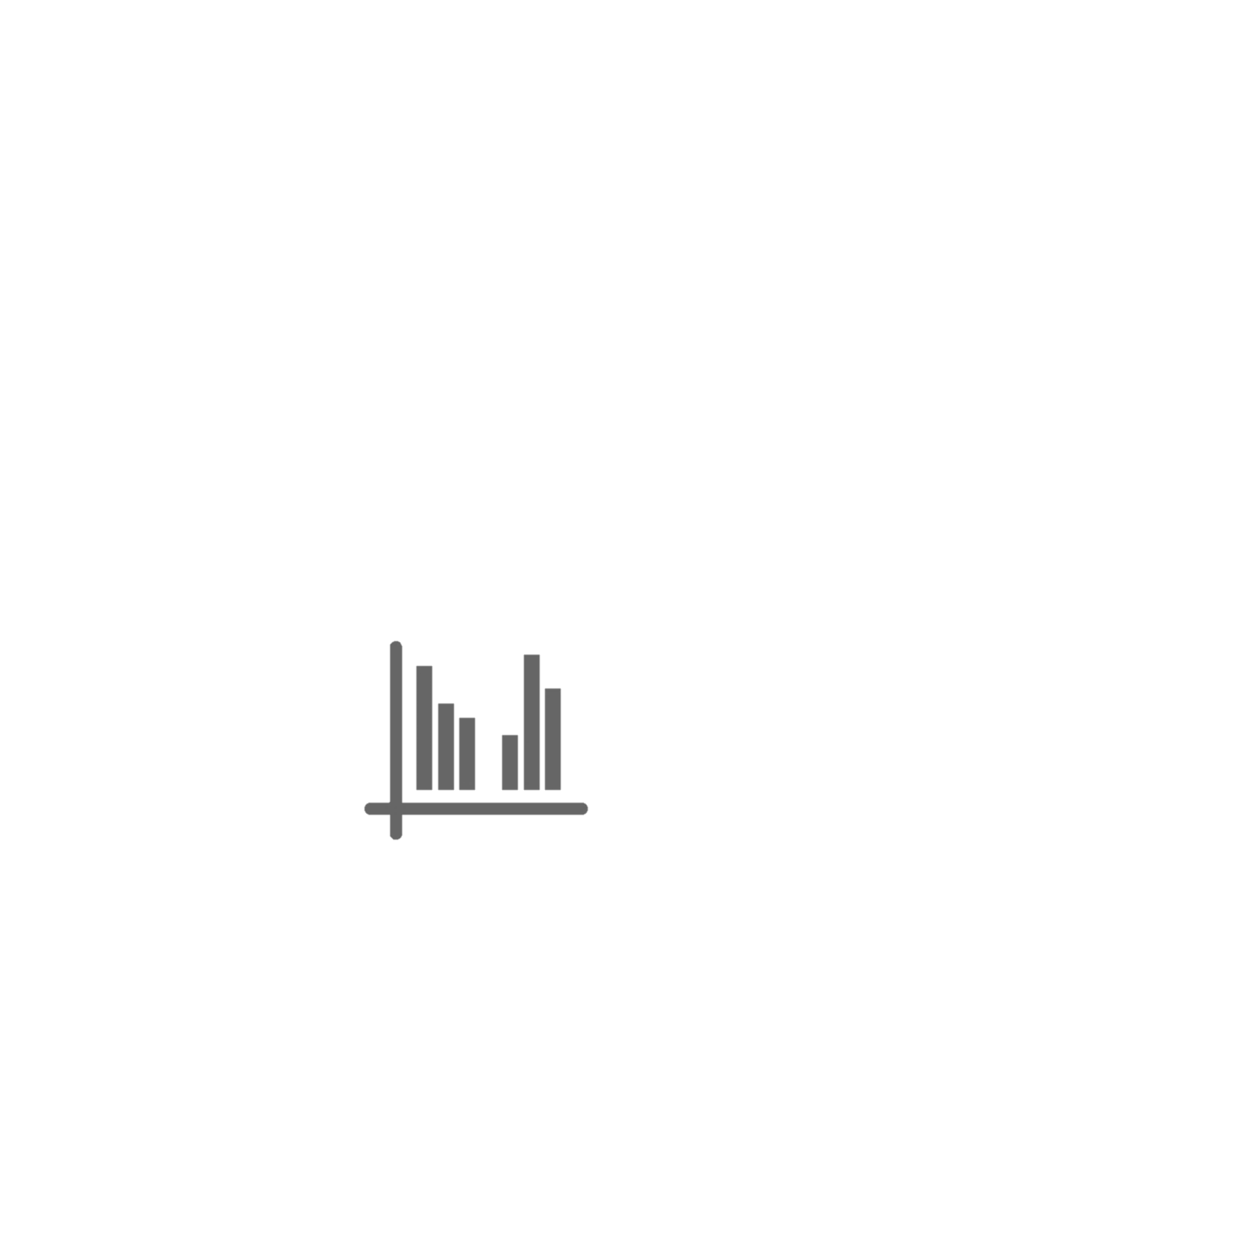

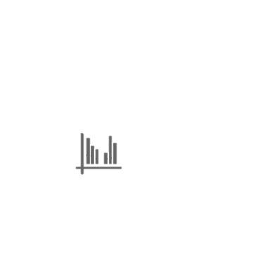
01
Introduction
Intro
duction
Used
Data
Used
Skills
Con
clusion
Progress of Project
Analysis
Process
Apply
Supplement
model 1
models
→
model 2
.csv
models
model 3
Features ,
……
Notes:
The procedure of the project is as follows. First, we analyzed the data provided by kkbox. After that, we selected 3 machine learning models suitable for the data and preprocessed the data accordingly. The results were derived through machine learning and then we modified data and code to improve accuracy.

Slide 5
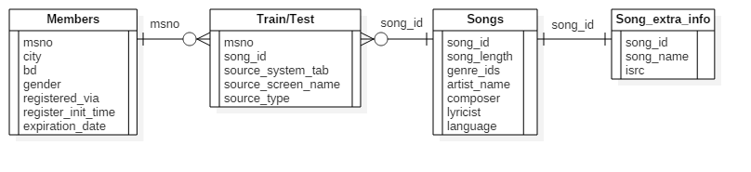
02
Used Data
Intro
duction
Used
Data
Used
Skills
Con
clusion
Data structure
Most features of data are categorical data, especially, nominal data (there is no order between categories)
Some features, kind of genre number or singer, have multi valued attribute divided by ‘|’. This means that this data set is not in first normal form.
‘Members.csv’ file is not a complete data file. Especially for age feature.
Notes:
For data analysis, we analyzed the structure of data first. On this picture, you can see the relationship between data sets. Through this, we can get 3 important points. First, most features of data are categorical data. It means that these data are nominal data, so there is no order between the categories. Second, Some features, including genre number and singer, have multiple values separated by a bar (|). This means that the given data set does not satisfy the first normal form. Last, members file is not a complete data file, especially for age feature.

Slide 6
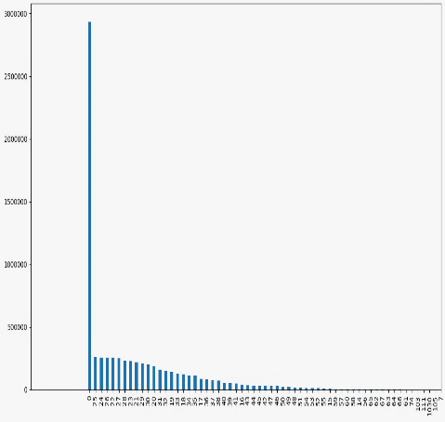
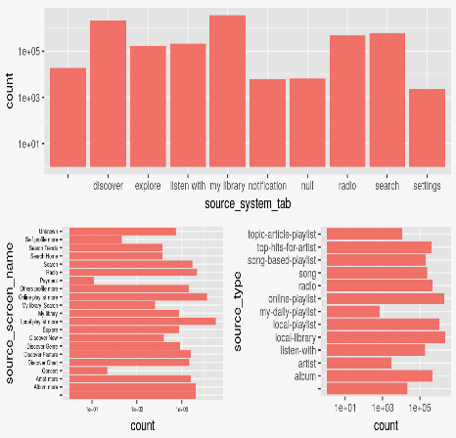
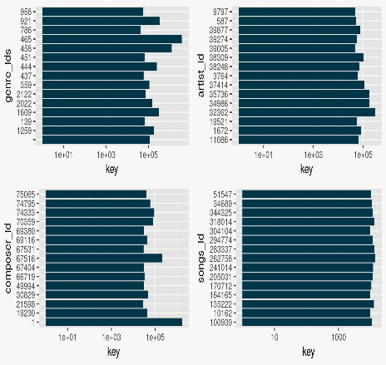
02
Used Data
Intro
duction
Used
Data
Used
Skills
Con
clusion
Data Analysis
members
train/test
songs/song_extra_info
Uncompleted data set
Show information about users
Show frequency about choice of users on menu by menu
Also on name by name and type by type
Show distribution about categories of songs by each ids
Notes:
Because of that last point, we can see a lot of users whose age is 0. That means there are many people who did not put their age information. After that, we saw other data sets. Through that, we were able to get information about the frequency of the method that the user approached the song. Also get distribution about categories of songs by each ids.
After these analysis, we did preprocess on these data sets to use in three models.

Slide 7
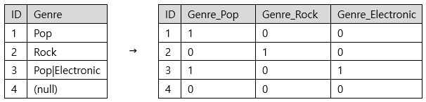
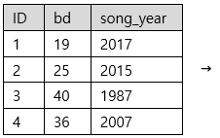
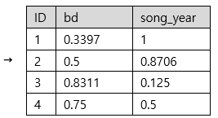
03
1. Neural Network: Data Preprocessing
Intro
duction
Used
Data
Used
Skills
Con
clusion
Categorical Features
(Dummy Features)
Conversion to Numerics
Scaling and Normalization
Nonlinear Transformation
Binary Features
Gender: Male, Female, (null) → 1, 0, 0.5
Numeric Features
Input
Layer
Hidden
Layer…
Function
Notes:
The first model is neural network. It can only accept numbers, so the categorical features should be converted to numbers appropriately. The most frequently used method is to make dummy features, which are binary features indicating whether the values of the feature belong to the specific category. In the case of numbers, several literatures state that it is effective to scale the numbers into the similar ranges. We adjusted the numbers in the range between 0 and 1. For some features, we applied some nonlinear transformations before scaling if they are necessary. We finally put the all features together and used as inputs of neural networks.

Slide 8
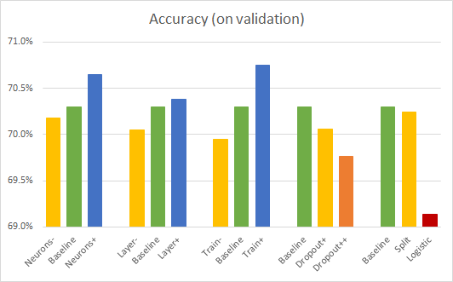
03
1. Neural Network: Results
Intro
duction
Used
Data
Used
Skills
Con
clusion
Observations:
More neurons, more layers, and more train lead to the better results.
Dropout does not produce better results.
Activation Function: The ReLU is better than the logistic function.
NNs seem to be not quite effective for problems with mostly categorical features.
Notes:
We tried several different configurations of the networks. We changed the number of neurons, the number of layers, and training time. We also applied dropouts, changed the activation function of the neurons, and split the inputs to feed them to different layers. The results show that more neurons, more layers, and more train lead to the better results. However, the dropout and the logistic activation function seems to be not working well in this project. Generally, we could observe the neural networks seem to be not quite effective to the problems with many categorical features like this one, compared to the other models.

Slide 9
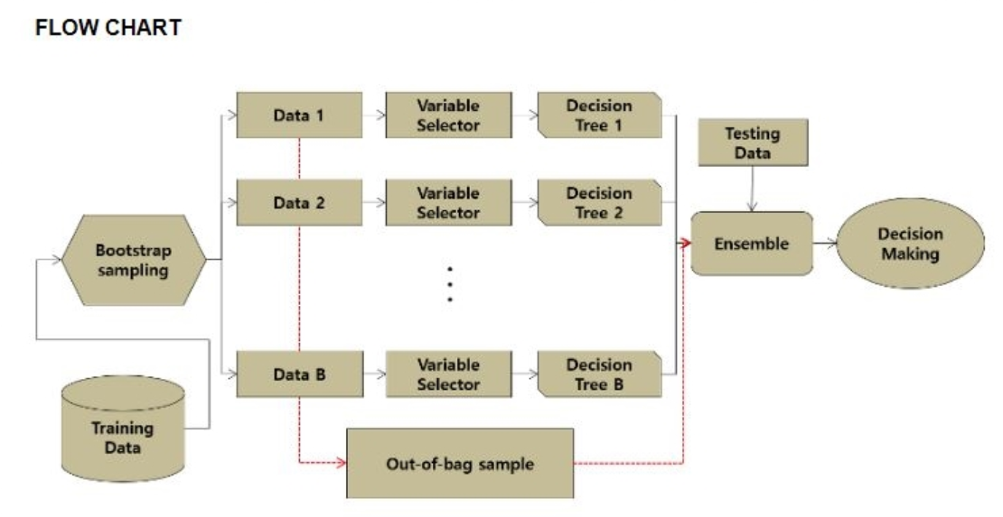
03
2. Random Forest: Algorithm
Intro
duction
Used
Data
Used
Skills
Con
clusion
Bootstrap?
- Allow duplication in given train data to create data of the same size as the original data
1. Create N Bootstrap samples.
2. Create N trees with arbitrary Bootstrap samples and variables.
3. Train each trees in the ensemble.
4. Select the prediction result by voting method.
Notes:
The second model we used is Random Forest. I will briefly explain the principle of this model.
The concept you need to know before describing is bootstrap.
Bootstrap is creating data of the same size as the original data by Allowing duplication in given train data.
The order is as follows. We first create N bootstrap samples and use them to create N trees. Next the model train each trees in ensemble. Then it selected the result of the prediction as a voting method.
순서는 다음과 같습니다. 먼저 N개의 bootstrap sample을 만들고 그것을 이용하여 n개의 결정트리를 생성합니다. 각각의 앙상블(트리)로 부터 train classifier를 만듭니다. 그 후 예측 결과를 투표방식으로 선택합니다.
우리가 두번째로 이용한 모델은 Random Forest입니다. 이 모델의 원리를 간단하게 설명해드리겠습니다.
설명하기에 앞서 알아야 할 개념은 bootstrap입니다.
1. N개의 Bootstrap sample 생성
2. 임의의 Bootstrap sample과 변수로 N개의 tree 생성
3. 각각의 앙상블로부터 train classifier 생성
4. 예측결과를 투표방식으로 선택
-Bootstrap? 주어진 train data에서 중복을 허용하여 원래 데이터와 같은 크기의 데이터를 만드는것

Slide 10
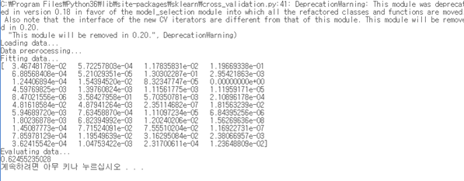
03
2. Random Forest: Results
Intro
duction
Used
Data
Used
Skills
Con
clusion
Observations:
Not recommended if the number of features is large.
Black boxed algorithm
-> Lost explanatory power which is advantage of decision tree
Notes:
Some data set will be not classified meaningfully, when using chosen features. So this method is not recommended if the number of features is large.
Random forest lost explanatory power which is advantage of decision tree, as a black boxed algorithm.
-Data set이 큰 경우 또는 feature의 수가 많은 경우 권장X
->classifier 알고리즘의 특징
-black box와 같은 알고리즘
-> decision tree의 장점인 설명력을 잃음

Slide 11
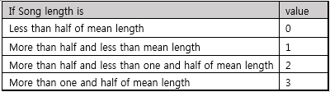
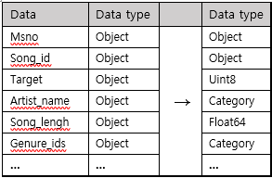
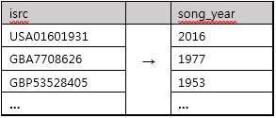
03
3. Gradient Boosting Machine: Data Preprocessing
Intro
duction
Used
Data
Used
Skills
Con
clusion
1. Data modification and type definition
2. Add features related with songs
Song_length: NA value -> mean value
Type definition
Score according to the song length
Number of times the song was played
3. Add features related with time
4. Features related with producers
1. Expiration period segmentation
2. Registration period segmentation
3. Song’s releasing year
Whether the song is featured
The number of song’s artists, composer, lyricists
Whether the artist and the composer are the same
Whether the artist, composer, lyricist are the same
Notes:
The Third model is Gradient Boosting. What we have spent most of our time in Gradient Boosting was to add new features from the given data. This is because GBM has more accuracy as you add more valid features. The features we have added can be divided into four major categories. The first is to modify the incorrect data and specify the type of data. For example, if NA value is found in song length data, it is replaced with average value, and then we clarifies the data type of the feature where the existing type was object.
The second is Adding features of the song. we add score feature depending on the length of the song, Also we add the number of times the song has been played.
The third is Adding features of time. We subdivided the user's expiration time and registration time, and added the song release year using isrc which is the unique ID of the song.
The Fourth is Adding features of song’s producer. We have added features such as whether this song is featured, the number of artists, composers, lyricists and whether artists and composers are the same.
GBM에서 우리가 가장 시간을 들였던 것은 우리가 가지고 있는 데이터에서 새로운 특징을 추가하는 것이 었습니다. 왜냐하면 GBM은 유효한 특징을 추가하면 추가할수록 정확도가 높아졌기 때문입니다. 우리가 추가한 특징은 크게 4가지로 나눌 수 있습니다. 첫번째는 올바르지 못한 데이터를 수정하고 데이터의 타입을 지정하는 것입니다. 예를 들면 노래의 길이 데이터 중 NA값이 있으면 평균값으로 대체하고 기존의 타입이 object였던 Feature들의 데이터 타입을 명확화 시켜줍니다.
두번째는 노래의 관련된 특징추가입니다. 노래의 길이에 따라 다음과 같이 점수를 부여하거나 노래가 재생된 횟수를 추가합니다.
세번째는 시간과 관련된 특징추가입니다. 사용자의 만료시간, 등록시간을 세분화하고 노래 고유 아이디인 isrc를 이용해 노래 발매 년도를 추가하였습니다.
네번째로 노래 제작자와 관련된 특징추가입니다. 이 노래가 피쳐링되었는지, 아티스트, 작곡가, 작사가가 각각 몇 명인지, 아티스트와 작곡가가 같은 지 등의 특징을 추가 하였습니다.

Slide 12
03
3. Gradient Boosting Machine: Results
Intro
duction
Used
Data
Used
Skills
Con
clusion
Observations:
Learning rate = 0.2, number of boosting = 100 is best set to our data.
Accuracy goes high when meaningful data was added.
Gradiet Boosting Machine is effective for problems with mostly categorical features.
Notes:
By using Gbm, the accuracy records 80.6% and the accuracy of actual test data was 68.7%.
Important parameters of gbm are the learning rate and boosting frequency. when learning rate and boosting frequency were 0.2 and 100, The accuracy of the actual test data was highest. When we lower the the learning rate, the validation showed higher accuracy, but the actual test data showed overfitting with lower accuracy.
Also, gbm generally shows the accuracy increase when adding features. However, the accuracy of actual test data increased only when the feature was a valid Feature.
Gbm을 통해서 80.6%의 정확도를 기록하였다. 실제로 test데이터에서는 68.71%의 정확도를 기록하였다. 모델의 주요 변수인 learning rate는 0.2 boosting 횟수 100일 때 실제 test데이터에 대한 정확도가 제일 높았다. Learning rate을 낮게 잡았을 때 validation에서 더 높은 정확도를 보였지만 실제 테스트 데이터에서는 정확도가 오히려 낮아지는 overfitting을 보여주었다.
또한 gbm은 일반적으로 Feature들을 추가하였을 때 정확도가 증가하는 모습을 보여주었다. 하지만 그 Feature가 유효한 Feature일때만 실제 테스트 데이터의 정확도가 증가하였다.

Slide 13
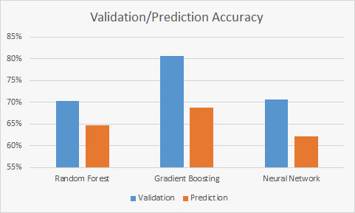
04
Conclusion
Intro
duction
Used
Data
Used
Skills
Con
clusion
Notes:
We tried to solve the problem by using three kinds of machine learning model, and the GBM was the best predictor among these models. In the case of Random Forest, the degree of overfitting was found to be lower than that of the other models. Neural networks were found to have poor prediction accuracy due to the nature of categorical data.
When we started project, we had no background on machine learning, but it was a good opportunity to deal with various data and models.
It was also impressive that we were able to analyze the large amount of customer data that the actual company had. I think this experience will be practical help for us.

Slide 14
Thank you
Notes:
Our presentation is over. Thank you for listening. Thank you.

Slide 15
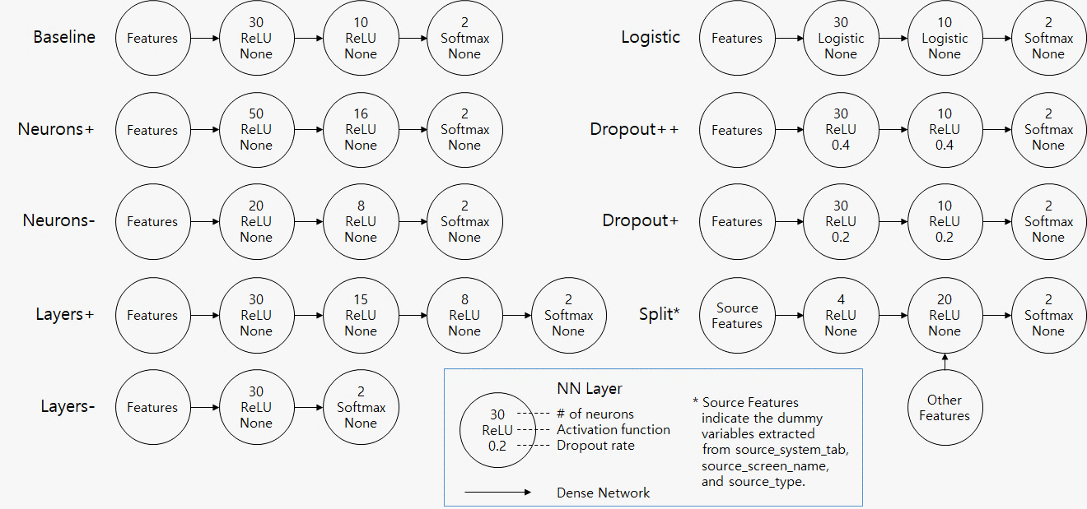
05
Appendix: Details of Neural Network Configurations
Intro
duction
Used
Data
Used
Skills
Con
clusion

